Slide 1
Econ 7900
Statistics for Data Science
Instructor: CAO Kang Hua 曹康華
Lecture 7
Multiple Regression

Slide 2
Using Several Variables to Predict a Response

Slide 3
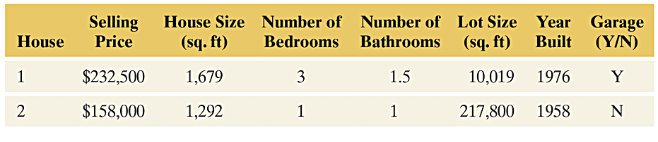
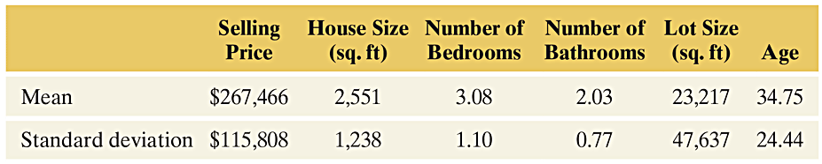
Example: Predicting the Selling Price of a House
The data set “house selling prices” contains observations on 200 home sales in Oregon. A multiple regression analysis was done with selling price as the response variable and with house size, number of bedrooms, and number of bathrooms as the explanatory variables.
Table 13.1 Selling Prices and Related Factors for a Sample of Home Sales
Table 13.2 Descriptive Statistics for Sales of 200 Homes
Notes:
3

Slide 4
Multiple Regression
You can find a regression equation to predict selling price by treating one of the other variables as the explanatory variable. However, since there are several explanatory variables, you might make better predictions by using all of them at once. That’s the idea behind multiple regression. It uses more than one explanatory variable to predict a response variable.
Notes:
4

Slide 5
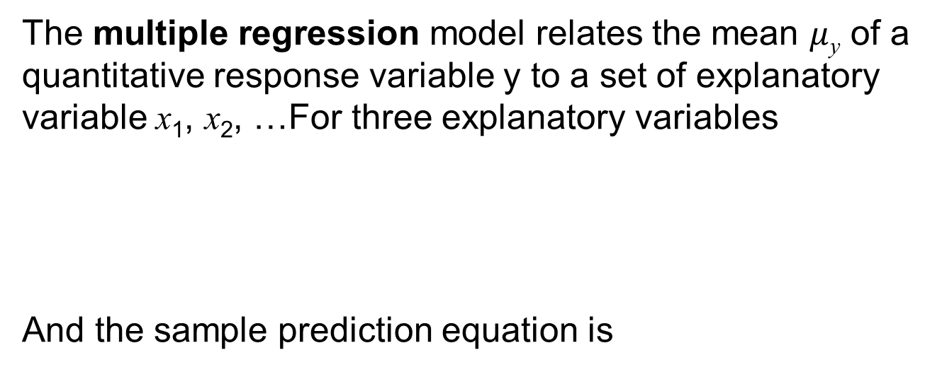
Multiple Regression Model
The multiple regression model relates the mean $μ$_{y} of a quantitative response variable y to a set of explanatory variable x₁, x₂, …For three explanatory variables
And the sample prediction equation is
Notes:
5

Slide 6
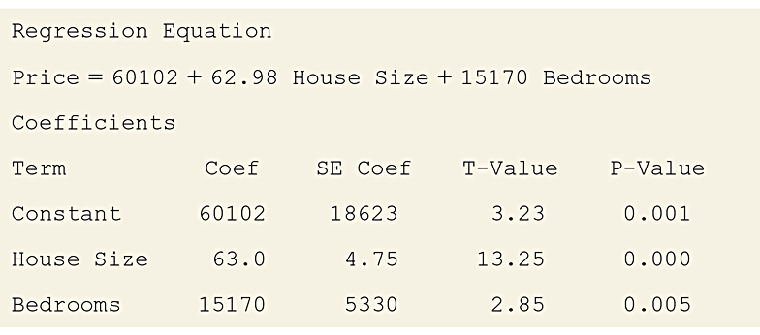
Example: Predicting the Selling Price of a House
Output from the analysis:
Table 13.3 Regression of Selling Price on House Size and Bedrooms
Notes:
6

Slide 7
Example: Predicting Selling Price Using House Size and Number of Bedrooms
Prediction Equation:
where ŷ is the predicted price.
Notes:
7

Slide 8
Example: Predicting Selling Price Using House Size and Number of Bedrooms
One house listed in the data set had house size = 1679
square feet, number of bedrooms = 3:
Find its predicted selling price:
Notes:
8

Slide 9
Example: Predicting Selling Price Using House Size and Number of Bedrooms
Find its residual, prediction error:
The residual tells us that the actual selling price was
$21,111 higher than predicted.
Notes:
9

Slide 10
The Number of Explanatory Variables
You should not use many explanatory variables in a
multiple regression model unless you have lots of data.
A rough guideline is that the sample size n should be at
least 10 times the number of explanatory variables.
For example, to use two explanatory variables, you
should have at least n = 20.
Notes:
10

Slide 11
Plotting Relationships
Always look at the data before doing a multiple regression.
Most software has the option of constructing scatterplots on a single graph for each pair of variables.
  This is called a scatterplot matrix.
Notes:
11

Slide 12
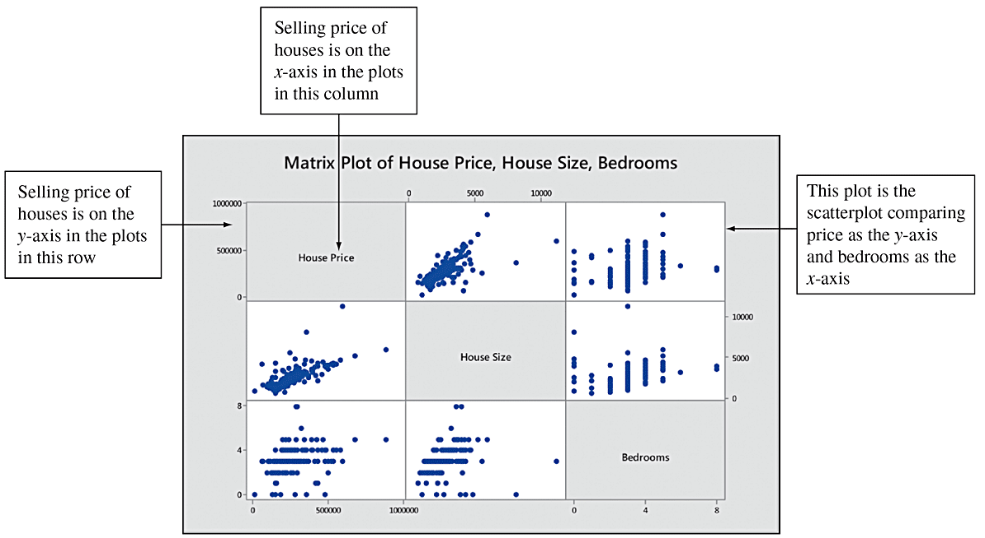
Plotting Relationships
Figure 13.1 Scatterplot Matrix for Selling Price, House Size, and Number of Bedrooms The middle plot in the top row has house size on the x-axis and selling price on the y-axis. The first plot in the second row reverses this, with selling price on the x-axis and house size on the y-axis. Question: Why are the plots of main interest the ones in the top row?
Notes:
12

Slide 13
Interpretation of Multiple Regression Coefficients
The simplest way to interpret a multiple regression
equation is to look at it in two dimensions as a function of a single explanatory variable.
We can look at it this way by fixing values for the other
explanatory variable(s).
Notes:
13

Slide 14
Interpretation of Multiple Regression Coefficients
Example using the housing data:
Suppose we fix x₁ = house size at the value of 2,000 square feet.
The prediction equation becomes:
ŷ = 60,102 + 63.0(2,000) + 15,170(x₂).
Notes:
14

Slide 15
Interpretation of Multiple Regression Coefficients
Since the slope coefficient of x₂ is 15,170, the predicted
selling price increases by $15,170 for every bedroom added.
Likewise, for houses with three bedrooms, the predicted selling price increases by $63 for every additional square foot in house size or $6300 for every 100 square foot in size increase.
Notes:
15

Slide 16
Summarizing the Effect While Controlling for a Variable
The multiple regression model assumes that the slope for
a particular explanatory variable is identical for all fixed
values of the other explanatory variables.
Notes:
16

Slide 17
Summarizing the Effect While Controlling for a Variable
For example, the coefficient of x₁ in the prediction equation:
is 63.0 regardless of whether we plug in x₂ = 1 or x₂ = 2 or x₂ = 3.
Notes:
17

Slide 18
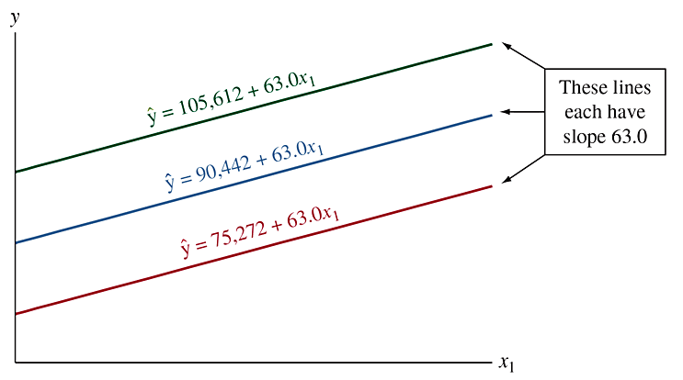
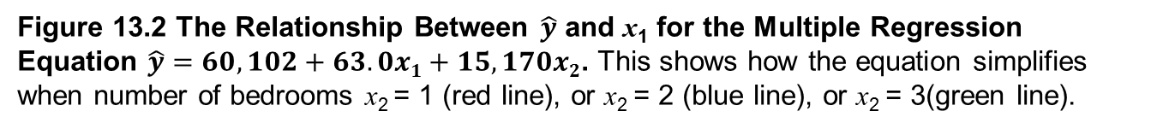
Summarizing the Effect While Controlling for a Variable
Figure 13.2 The Relationship Between $\hat{y}$ and x₁ for the Multiple Regression Equation $\hat{y}=60,102+63.0x1+15,170x2$. This shows how the equation simplifies when number of bedrooms x₂ = 1 (red line), or x₂ = 2 (blue line), or x₂ = 3(green line).
Notes:
18

Slide 19
Extending the Correlation and
R² for Multiple Regression

Slide 20
Multiple Correlation, R
To summarize how well a multiple regression model
predicts y, we analyze how well the observed y values
correlate with the predicted ŷ values.
The multiple correlation is the correlation between the
observed y values and the predicted ŷ values. It is denoted by R.
Notes:
20

Slide 21
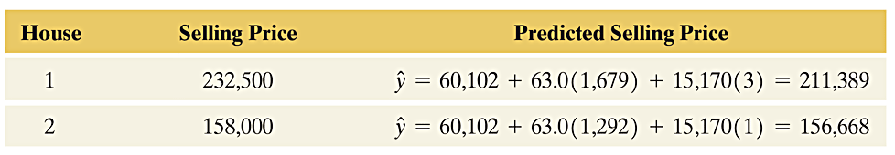
Multiple Correlation
For each subject, the regression equation provides a
predicted value.
Each subject has an observed y value and a predicted y value.
Table 13.4 Selling Prices and Their Predicted Values. These values refer to the two home sales listed in Table 13.1. The predictors are x₁ = house size and x₂ = number of bedrooms.
Notes:
21

Slide 22
Multiple Correlation
The correlation computed between all pairs of observed
y values and predicted y values is the multiple
correlation, R.
The larger the multiple correlation, the better are the
predictions of y by the set of explanatory variables.
Notes:
22

Slide 23
Multiple Correlation
R always falls between 0 and 1.
In this way, the multiple correlation ‘R’ differs from the
bivariate correlation ‘r’ between y and a single variable x,
which falls between –1 and +1.
Notes:
23

Slide 24
R²
For predicting y, the square of R describes the relative
improvement from using the prediction equation instead
of using the sample mean, ӯ.
The error in using the prediction equation to predict y is
summarized by the residual sum of squares:
Notes:
24

Slide 25
R²
The error in using ӯ to predict y is summarized by the
total sum of squares:
The proportional reduction in error is:
Notes:
25

Slide 26
R²
The better the predictions are using the regression equation, the larger R² is.
For multiple regression, R² is the square of the multiple correlation, R.
Notes:
26

Slide 27
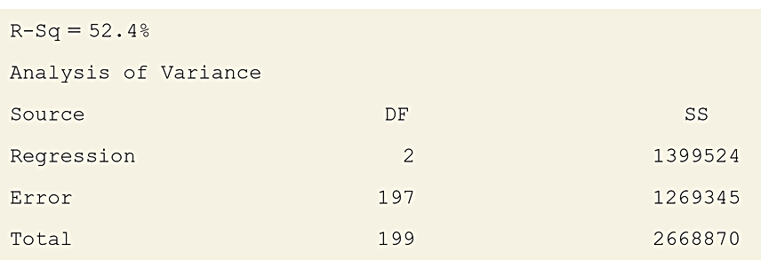
Example: Predicting House Selling Prices
For the 200 observations on y = selling price, x₁ = house size, and x₂ = number of bedrooms, a table, called the ANOVA (analysis of variance) table was created.
The table displays the sums of squares in the SS column.
Table 13.5 ANOVA Table and R² for Predicting House Selling Price (in thousands of dollars) Using House Size (in thousands of square feet) and Number of Bedrooms
Notes:
27

Slide 28
Example: Predicting House Selling Prices
The R² value can be created from the sums of squares in the table
Notes:
28

Slide 29
Example: Predicting House Selling Prices
Using house size and number of bedrooms together to predict selling price reduces the prediction error by 52%, relative to using ӯ alone to predict selling price.
Notes:
29

Slide 30
Example: Predicting House Selling Prices
The multiple correlation between selling price and the two explanatory variables is.
There is a moderately strong association between the
observed and the predicted selling prices.
House size and number of bedrooms are very helpful in
predicting selling prices.
Notes:
30

Slide 31
Example: Predicting House Selling Prices
From the correlation matrix, we saw that the correlation between price and size of a house is r = 0.71. In that case, the r² measure for the simple regression model with just size as a predictor equals r² = 10.7122 = 0.50.
The multiple regression model has R² = 0.52, only a marginally larger value.
We appear to be just as well off with the simple model using house size as the predictor as using the multiple model. An advantage of using the simple model is easier interpretation of the coefficients.
Notes:
31

Slide 32
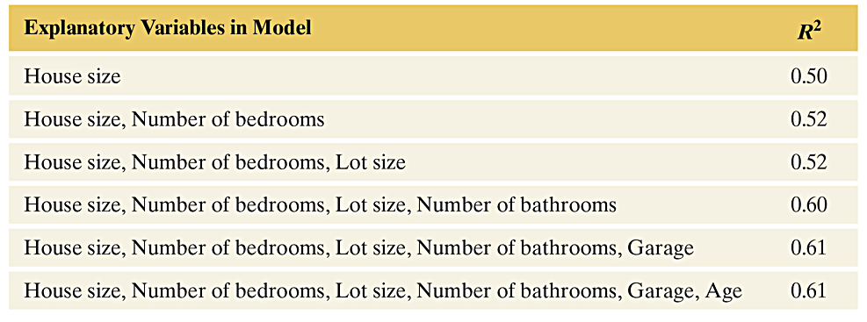
Example: Predicting House Selling Prices
Table 13.6 R² Value for Multiple Regression Models for y = House Selling Price
Notes:
32

Slide 33
Example: Predicting House Selling Prices
Although R² goes up by only small amounts after house size is in the
model, this does not mean that the other predictors are only weakly
correlated with selling price.
Because the predictors are themselves highly correlated, once one
or two of them are in the model, the remaining ones don’t help much
in adding to the predictive power.
For instance, lot size is highly positively correlated with number of
bedrooms and with size of house. So, once number of bedrooms
and size of house are included as predictors in the model, there’s not
much benefit to including lot size as an additional predictor.
Notes:
33

Slide 34
R² Often Does Not Increase Much After a Few Predictors
When there are many explanatory variables but the correlations among them are strong, once you have included a few of them in the model, R² usually doesn’t increase much more when you add additional ones. This does not mean that the additional variables are uncorrelated with the response variable but merely that they don’t add much new information for predicting y, given the values of the predictors already in the model.
Notes:
34

Slide 35
Inferences Using Multiple Regression

Slide 36
Inferences about the Population
Inferences require the same assumptions as in simple regression:
  The regression equation truly holds for the population means.
  The data were gathered using randomization.
  The response variable y has a normal distribution at each combination of values of the explanatory variables, with the same standard deviation.
Notes:
36

Slide 37
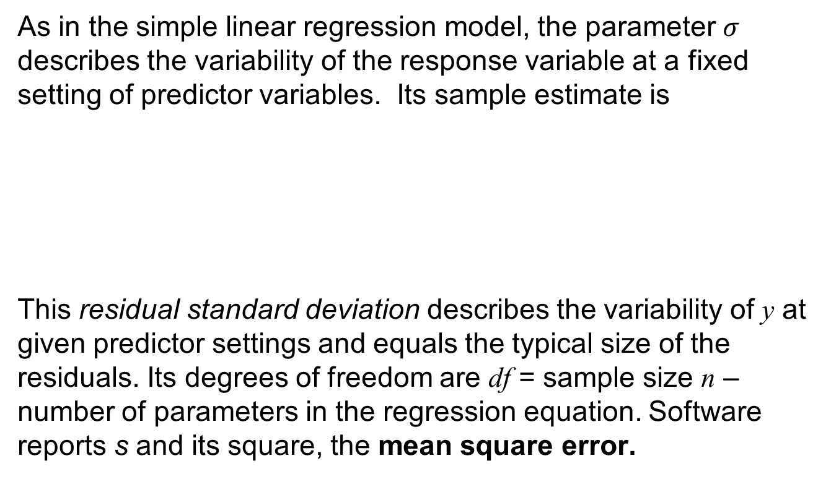
Estimating Variability Around the Regression Equation
As in the simple linear regression model, the parameter $σ$ describes the variability of the response variable at a fixed setting of predictor variables. Its sample estimate is
This residual standard deviation describes the variability of y at given predictor settings and equals the typical size of the residuals. Its degrees of freedom are df = sample size n – number of parameters in the regression equation. Software reports s and its square, the mean square error.

Slide 38
Example: Female Athlete’s Weight
The “College Athletes” data set comes from a study of 64 University of Georgia female athletes.
The study measured several physical characteristics, including total body weight in pounds (TBW), height in inches (HGT), the percent of body fat (%BF), and age.
Notes:
38

Slide 39
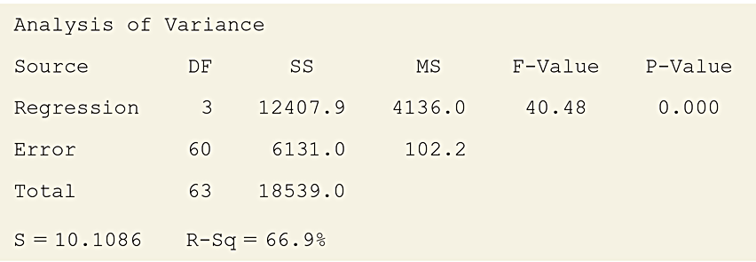
Example: Female Athlete’s Weight
The results of fitting a multiple regression model for predicting weight using the other variables:
Table 13.7 ANOVA Table for Multiple Regression Analysis of Athlete Weights
Notes:
39

Slide 40
Example: Female Athletes’ Weight
For female athletes at particular values of height, % of body fat, and age, estimate the standard deviation of their weights.
Begin by finding the Mean Square Error:
Notice that this value (102.2) appears in the MS column in the ANOVA table.
Notes:
40

Slide 41
Example: Female Athletes’ Weight
The residual standard deviation is:
This value is also displayed in the ANOVA table.
For athletes with certain fixed values of height, % body fat, and age, the weights vary with a standard deviation of about 10 pounds.
Notes:
41

Slide 42
Example: Female Athletes’ Weight
Insight:
If the conditional distributions of weight are approximately bell-shaped, about 95% of the weight values fall within about 2s = 20 pounds of the true mean as determined by the regression equation.
Notes:
42

Slide 43
The Collective Effect of Explanatory Variables
Example: With 3 predictors in a model, we can check this by testing:
H₀ states that the mean of y does not depend on any of the predictors in the model. H_{a} states that at least one explanatory variable is associated with y.
Notes:
43

Slide 44
The Collective Effect of Explanatory Variables
The test statistic for H₀ is denoted by F. It equals the ratio of the mean squares from the ANOVA table,
Notes:
44

Slide 45
The Collective Effect of Explanatory Variables
When H₀ is true, the expected value of the F test statistic is approximately 1.
When H₀ is false, F tends to be larger than 1.
The larger the F test statistic, the stronger the evidence against H₀.
Notes:
45

Slide 46
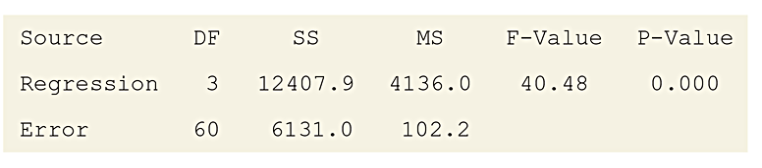
Example: Female Athlete’s Weight
ANOVA table for the “college athletes” data set:
Notes:
46

Slide 47
Example: Female Athlete’s Weight
Use the output in the ANOVA table to test the hypothesis:
Notes:
47

Slide 48
Example: Female Athlete’s Weight
From the ANOVA table, the observed F test statistic value is 40.48. Since this is well above 2.76, the P-value is less than 0.05.
The ANOVA table reports P-value = 0.000. If H₀ were true, it would be extremely unusual to get such a large F test statistic. We can reject H₀ at the 0.05 significance level.
Notes:
48

Slide 49
Example: Female Athlete’s Weight
Insight:
The F-test tells us that at least one explanatory
variable has an effect.
Notes:
49

Slide 50
Significance Test About a Multiple Regression Parameter
1. Assumptions:
Multiple regression model holds for population mean. This implies that there is a linear relationship between the mean of y and each explanatory variable, holding the others constant. The slope of this line is the same, no matter what the values for these other predictors.
Data gathered using randomization.
Normal distribution for y with same standard deviation at each combination of predictors.
Notes:
50

Slide 51
Example: What Helps Predict a Female Athlete’s Weight?
2. Hypotheses:
3. Test statistic:
Notes:
51

Slide 52
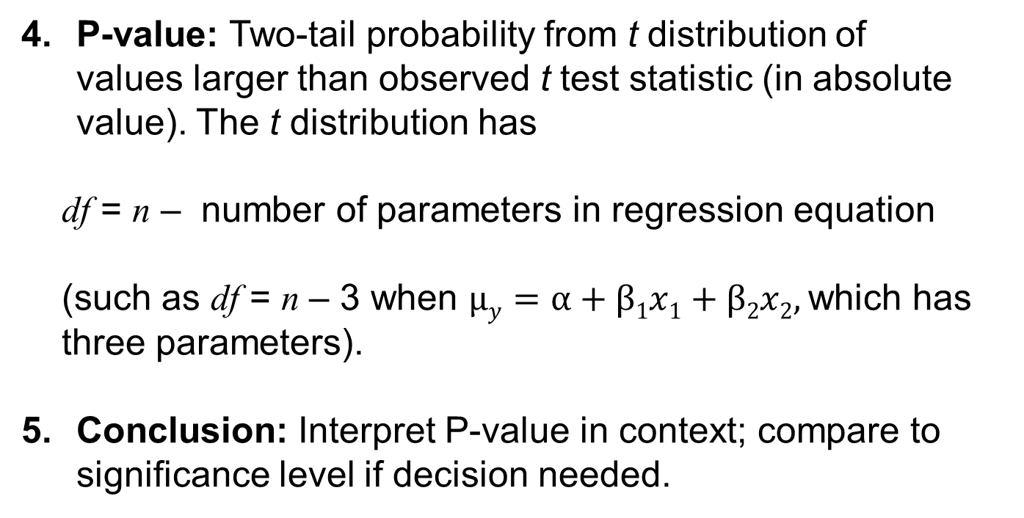
Example: What Helps Predict a Female Athlete’s Weight?
P-value: Two-tail probability from t distribution of values larger than observed t test statistic (in absolute value). The t distribution has
df = n – number of parameters in regression equation
(such as df = n – 3 when $μy=α+β1x1+β2x2,$which has
three parameters).
Conclusion: Interpret P-value in context; compare to significance level if decision needed.
Notes:
52

Slide 53
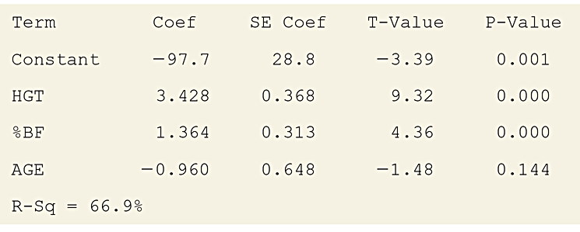
Example: Female Athlete’s Weight
Fitting a multiple regression model for predicting weight using the other variables. The predictive power is good, with R² = 0.669.
Table 13.10 Multiple Regression Analysis for Predicting Weight
Predictors are HGT = height, %BF = body fat, and age of subject.
Notes:
53

Slide 54
Example: What Helps Predict a Female Athlete’s Weight?
Run a hypothesis test to determine whether age helps to predict weight, if you already know height and percent body fat. Here are the steps:
1. Assumptions:
  The 64 female athletes were a convenience sample, not a random sample.
  Caution should be taken when making inferences about all female college athletes.
Notes:
54

Slide 55
Example: What Helps Predict a Female Athlete’s Weight?
2. Hypotheses:
3. Test statistic:
Notes:
55

Slide 56
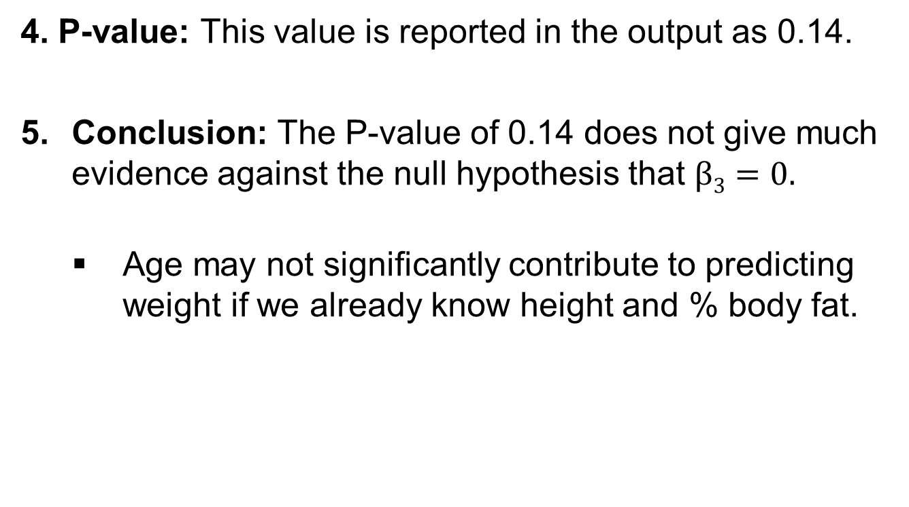
Example: What Helps Predict a Female Athlete’s Weight?
4. P-value: This value is reported in the output as 0.14.
Conclusion: The P-value of 0.14 does not give much evidence against the null hypothesis that $β3=0.$
  Age may not significantly contribute to predicting weight if we already know height and % body fat.
Notes:
56

Slide 57
Confidence Interval for a Multiple Regression Parameter
A 95% confidence interval for a β slope parameter in multiple regression equals:
The t-score has df = (n – # of parameters in the model).
The assumptions are the same as for the t test.
Notes:
57

Slide 58
Example: What’s plausible for the Effect of Age on Weight?
Construct and interpret a 95% CI for β₃, the effect of age while controlling for height and % body fat
Notes:
58

Slide 59
Example: What’s plausible for the Effect of Age on Weight?
At fixed values of x₁ and x₂, we infer that the population for the mean of weight changes very little (and maybe not at all) for a 1 year increase in age.
The confidence interval contains 0.
Age may have no effect on weight, once we control for
height and % body fat.
Notes:
59

Slide 60
Model Building
Unless the sample size is small and the correlation is weak between y and each explanatory variable, the F test usually has a small P-value. If the explanatory variables are chosen sensibly, at least one should have some predictive power.
When the P-value is small, we can conclude merely that at least one explanatory variable affects y. The more narrowly focused t inferences about individual slopes judge which effects are nonzero and estimate their sizes.

Slide 61
The Overall F Test is Done Before the Individual t Inferences
The F test is typically performed first before looking at the individual t inferences. The F test result tells us if there is sufficient evidence to make it worthwhile to consider the individual effects.
When there are many explanatory variables, doing the F test first provides protection from doing lots of t tests and having one of them be significant merely by random variation when, in fact, there truly are no effects in the population.

Slide 62
SUMMARY: The Process of Multiple Regression
Steps should include:
  Identify response and potential explanatory variables.
  Create a multiple regression model; perform appropriate tests (F and t) to see if and which explanatory variables have a statistically significant effect in predicting y.
  Plot y versus ŷ for resulting models and find R and R² values.
  Check assumptions (residual plot, randomization, histogram of standardized residuals).
  Choose appropriate model.
  Create confidence intervals for slope.
  Make predictions at specified levels of explanatory variables.
  Create prediction intervals.

Slide 63
Regression and Categorical Predictors

Slide 64
Indicator Variables
Regression models can specify categories of a categorical explanatory variable using artificial variables, called indicator variables.
  The indicator variable for a particular category is binary.
  It equals 1 if the observation falls into that category and it equals 0 otherwise.
Notes:
64

Slide 65
Indicator Variables
In the house selling prices data set, the condition of the house is a categorical variable. It was measured with categories (good, not good).
The indicator variable x for condition is
  x = 1 if house is in good condition.
  x = 0 if house is not in good condition.
Notes:
65

Slide 66
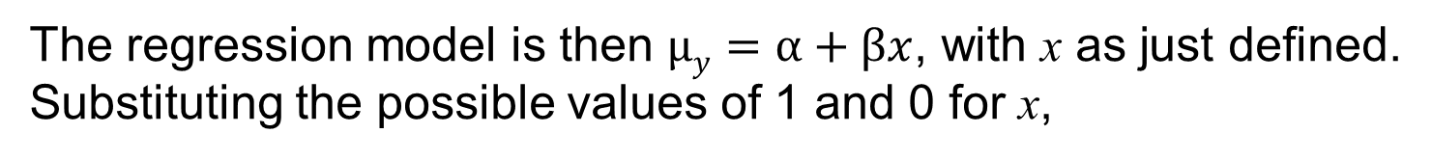
Indicator Variables
The regression model is then $μy=α+βx$, with x as just defined.
Substituting the possible values of 1 and 0 for x,
The difference between the mean selling price for houses in good condition and houses in not good condition is
Notes:
66

Slide 67
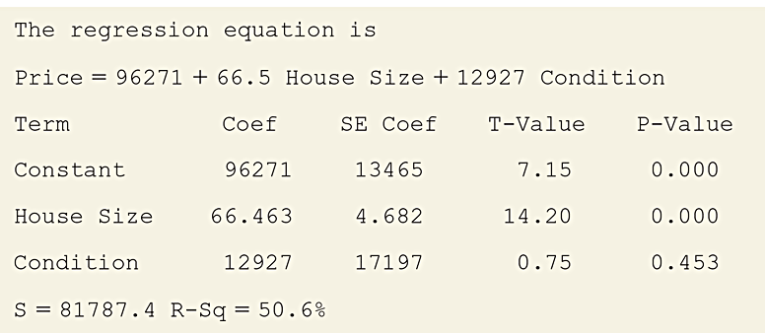
Example: Including Condition in Regression for House Selling Price
Output from the regression model for selling price of home using house size and condition
Table 13.11 Regression Analysis of y = Selling Price Using x₁ = House Size
and x₂ = Indicator Variable for Condition (Good, Not Good)
Notes:
67

Slide 68
Example: Including Condition in Regression for House Selling Price
Find and plot the lines showing how the predicted selling price varies as a function of house size for houses in good condition and for houses in not good condition.
Interpret the coefficient of the indicator variable for condition.
Notes:
68

Slide 69
Example: Including Condition in Regression for House Selling Price
Table 13.11 reports the prediction equation,
Notes:
69

Slide 70
Example: Including Condition in Regression for House Selling Price
For houses not in good condition, x₂ = 0.
The prediction equation then simplifies to:
Notes:
70

Slide 71
Example: Including Condition in Regression for House Selling Price
For houses in good condition, x₂ = 1.
The prediction equation then simplifies to:
Notes:
71

Slide 72
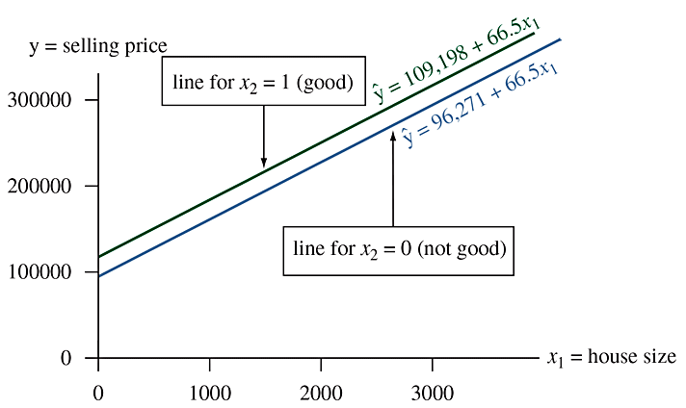
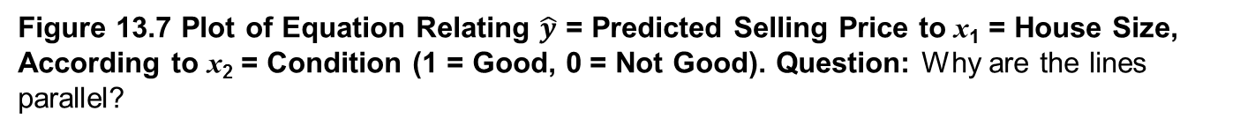
Example: Including Condition in Regression for House Selling Price
Figure 13.7 Plot of Equation Relating $\hat{y}$ = Predicted Selling Price to x₁ = House Size, According to x₂ = Condition (1 = Good, 0 = Not Good). Question: Why are the lines parallel?
Notes:
72

Slide 73
Example: Including Condition in Regression for House Selling Price
Both lines have the same slope, 66.5.
  The line for houses in good condition is above the other line (not good) because its y-intercept is larger. This means that for any fixed value of house size, the predicted selling price is higher for houses in better condition.
  The P-value of 0.453 for the test for the coefficient of the indicator variable suggests that this difference is not statistically significant.
Notes:
73

Slide 74
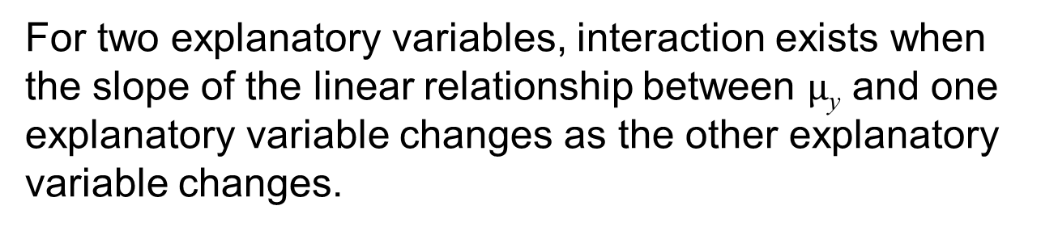
Determining Whether Interaction Exists
For two explanatory variables, interaction exists when the slope of the linear relationship between $μ$_{y} and one explanatory variable changes as the other explanatory variable changes.
Notes:
74

Slide 75
Example: Interaction in effects on House Selling Price
Suppose the actual population relationship between house size and the mean selling price is:
Then the slope for the effect of x₁ differs for the two conditions. There is then interaction between house size and condition in their effects on selling price.

Slide 76
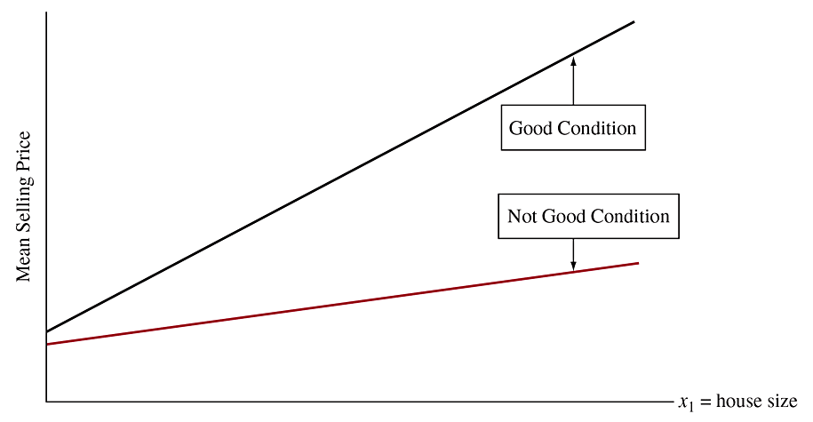
Example: Interaction in Effects on House Selling Price
Figure 13.8 An Example of Interaction. There’s a larger slope between selling price and house size for homes in good condition than in other conditions.
Notes:
76

Slide 77
Example: Interaction in Effects on House Selling Price
How can you allow for interaction when you do a regression analysis?
To allow for interaction with two explanatory variables,
one quantitative and one categorical, you can fit a
separate regression line with a different slope
between the two quantitative variables for each
category of the categorical variable.

